Slide 1
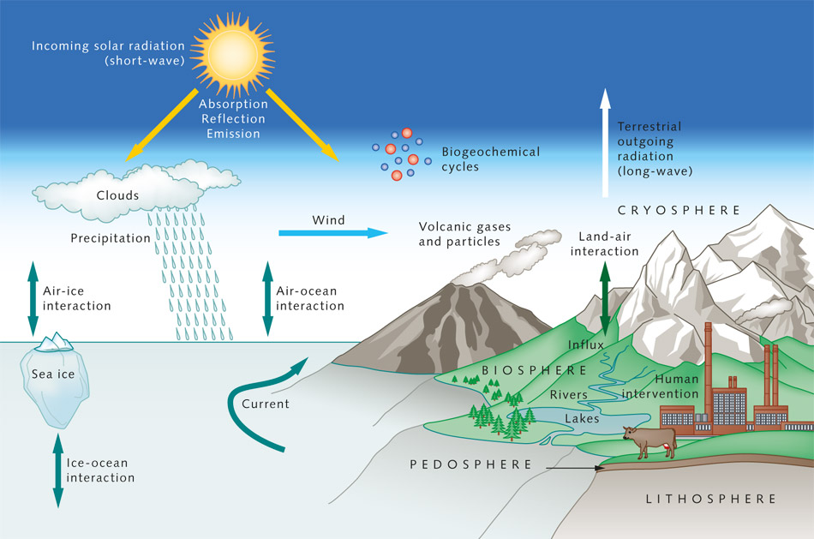
Welcome to Modeling Earth’s Climate!
Goal: to increase our literacy in anthropogenic climate change through the use of models.
Literacy …
is the condition or quality of being knowledgeable in a particular subject or field (e.g., cultural literacy).
Anthropogenic climate change …
Refers to human-caused changes in Earth’s climate. Doing so will require that we learn about how the pre-anthropogenic climate worked.
Models …

Slide 2
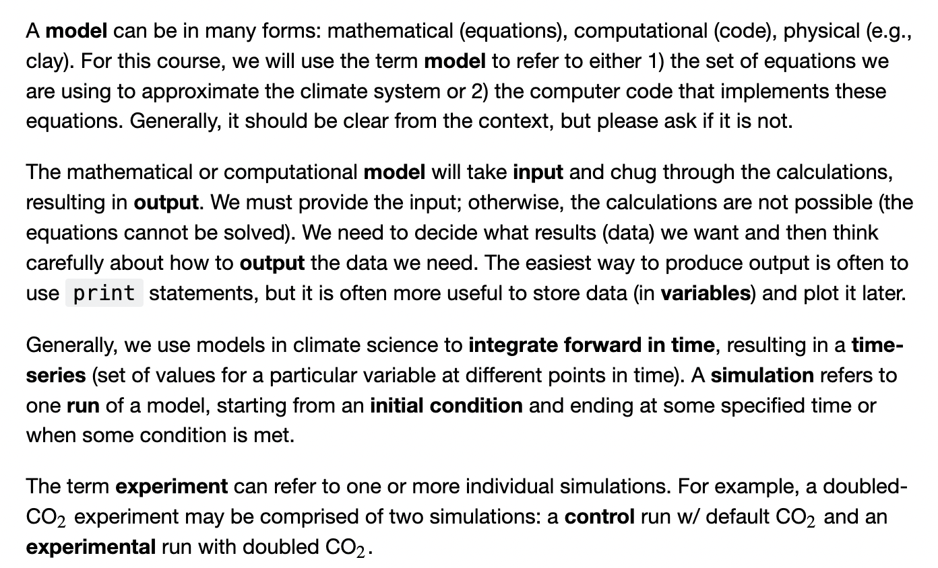
What’s a model, anyway*?
*From Professor Karen Shell, Oregon State University

Slide 3
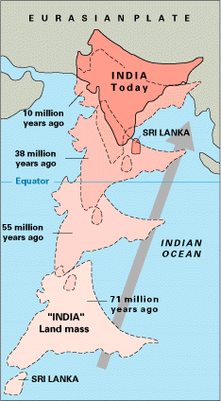
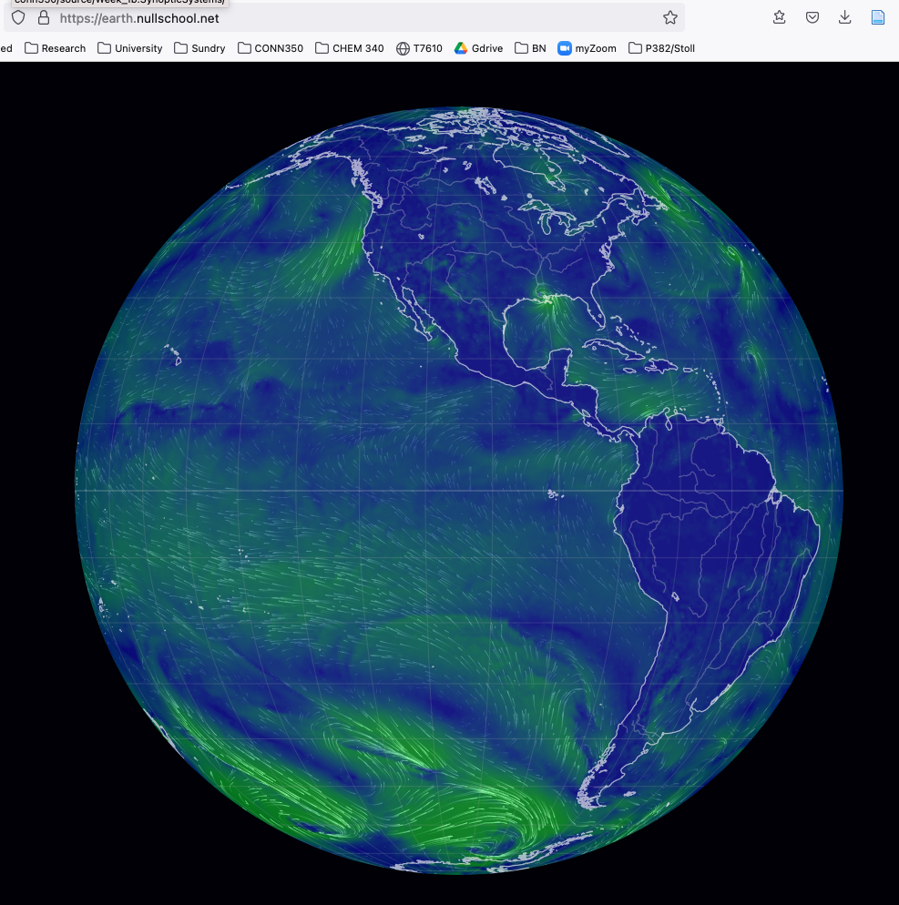
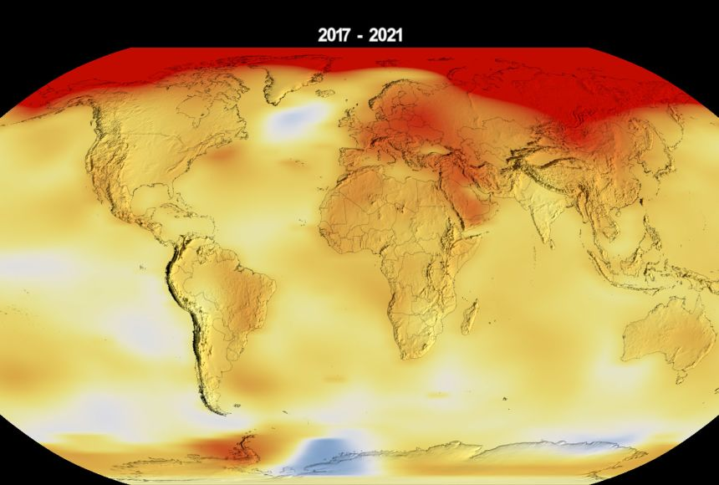
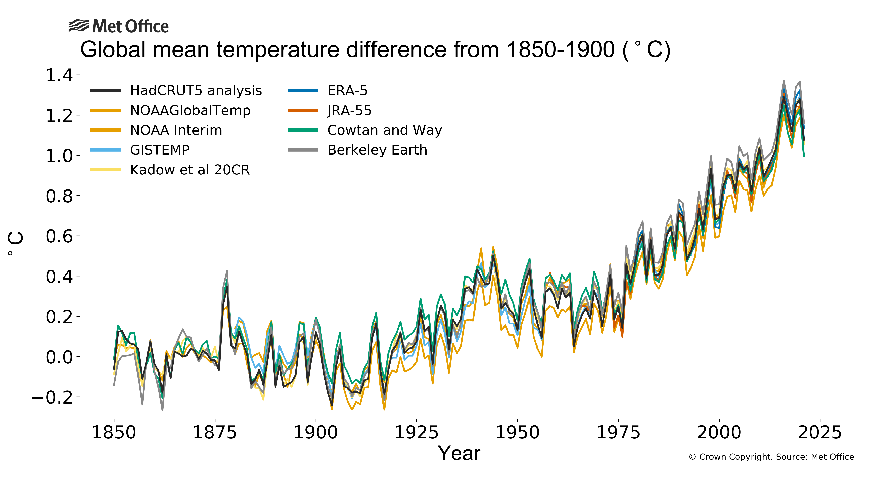
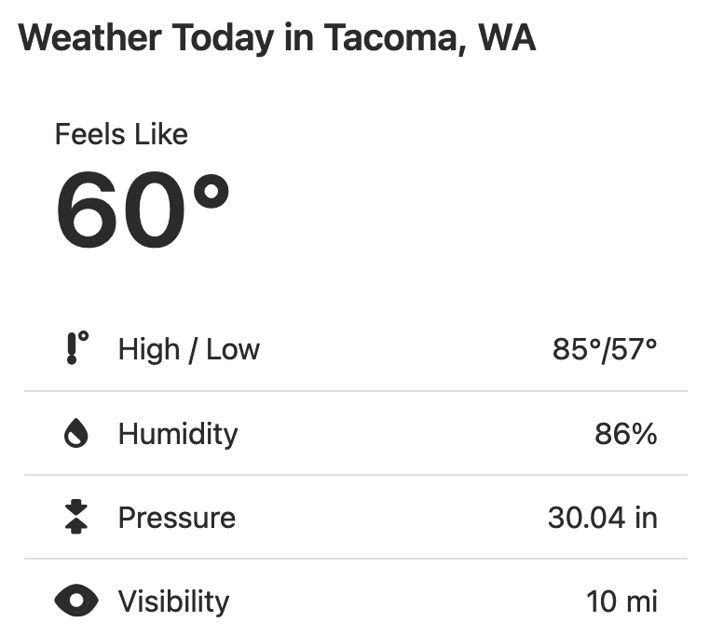
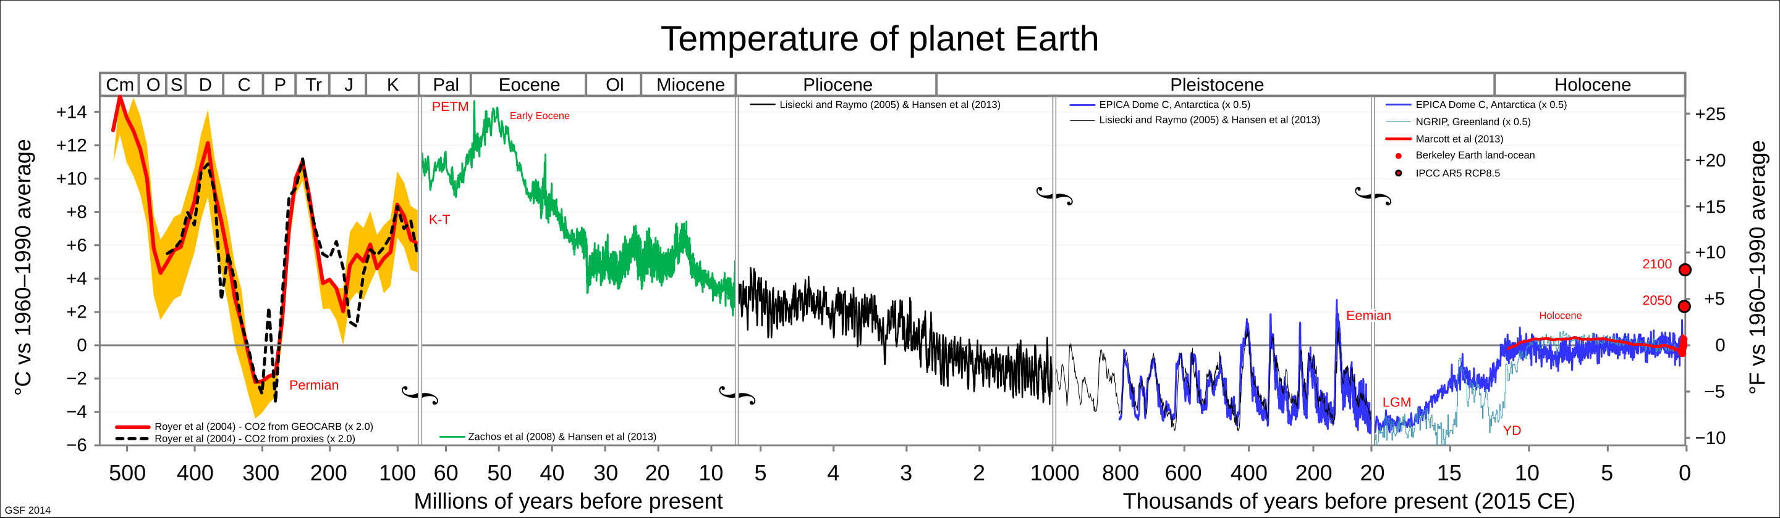
Whether we’re thinking about “weather” or “climate” depends on the time scale we’re interested in
Snapshots
(definitely weather)
10-100 years
(Anthropocene)
Millions of years
(Geological time scale)

Slide 4
Models we’ll be exploring
Global earth system weather tools (Earth.nullschool.net)
Web apps that demonstrate processes (phet)
Integrated assessment tools (include economics, politics: EnROADS)
Global climate models (“GCMs”) (Monash)
Global carbon cycles (Cambio, constructing your own in Python)
Conceptual frameworks for analyzing and engaging in climate change discourse

Slide 5
Course organization on Canvas
Resources you’ll need
Topic schedule (in the syllabus)
Weekly modules
Discussion posts and your research notebook
Contingencies for missing class
Evaluation

Slide 6
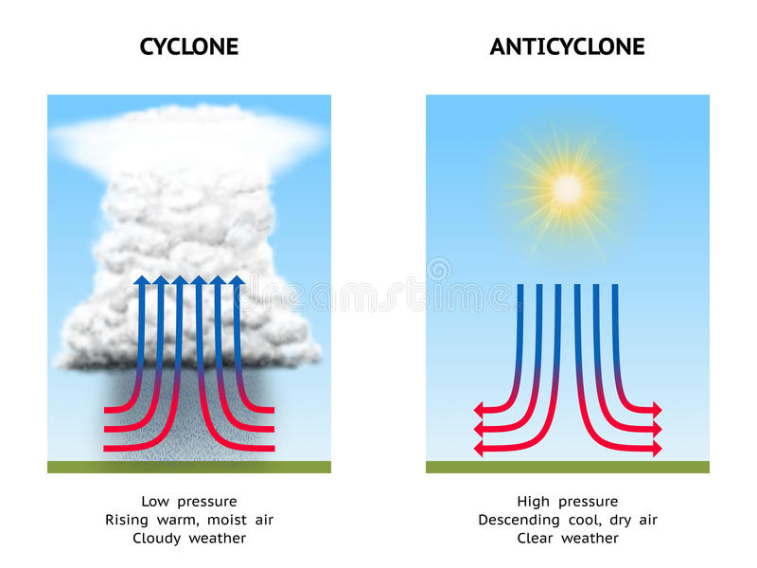
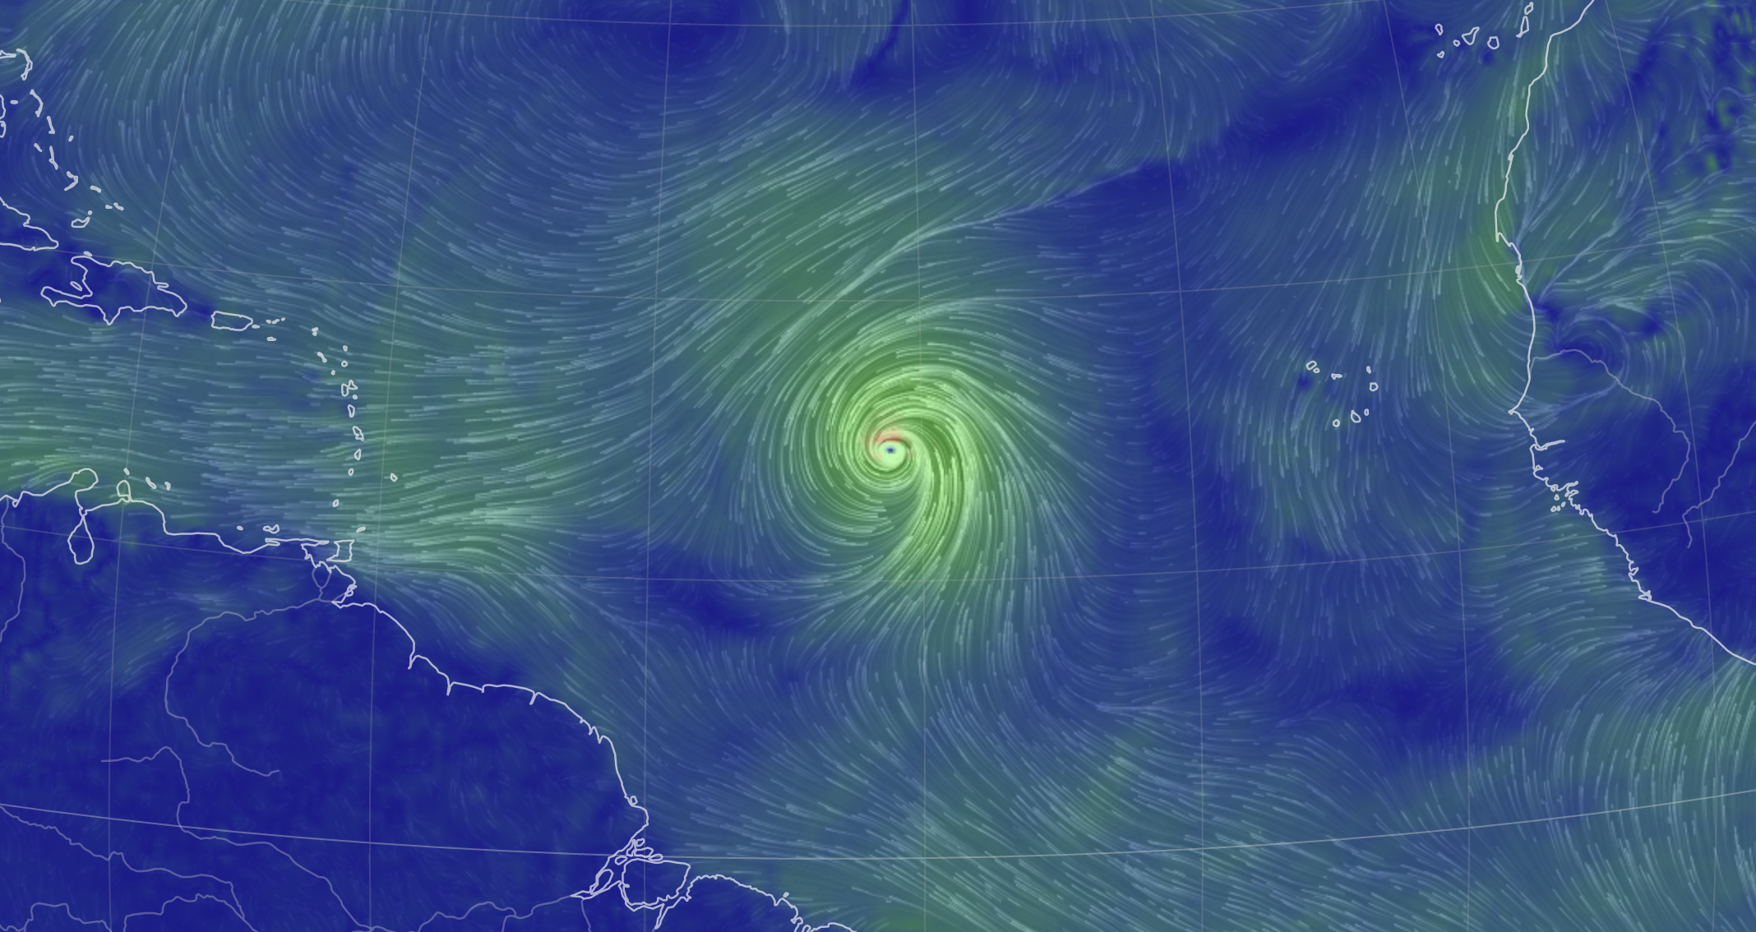
Diving into Earth.nullschool.net: recognizing cyclonic synoptic systems
Low-pressure system – stormy, cloudy, and rainy
Northern hemisphere, winds circling to the left
Southern hemisphere, winds circling to the right
https://thumbs.dreamstime.com/b/cyclone-anticyclone-diagram-illustrating-high-pressure-low-pressure-57971714.jpg

Slide 7
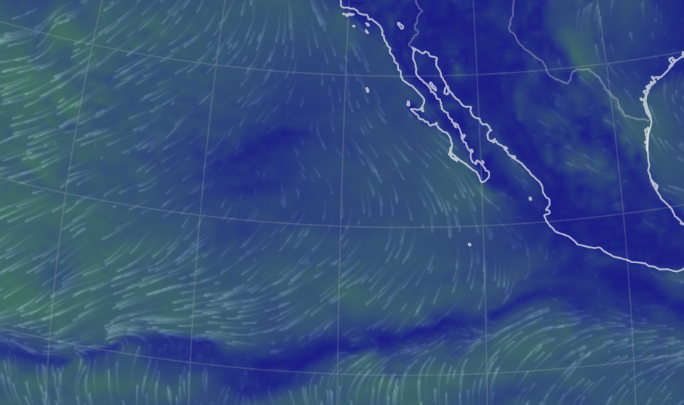
Diving into Earth.nullschool.net: recognizing anticyclonic synoptic systems
High-pressure system – Clear skies, dry
Northern hemisphere, winds circling to the right
Southern hemisphere, winds circling to the left
https://thumbs.dreamstime.com/b/cyclone-anticyclone-diagram-illustrating-high-pressure-low-pressure-57971714.jpg

Slide 8
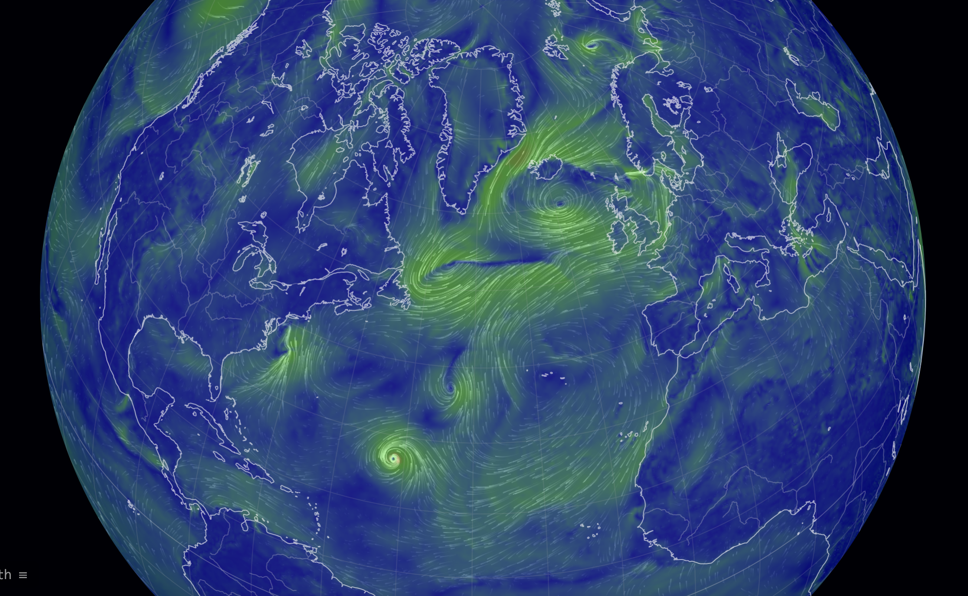
Turns out, some synoptic systems are semi-permanent
Famous semipermanent Lows:
Aleutians
Iceland
Off the coast of Antarctica
Famous Semipermanent Highs:
Hawaii
Bermuda
South Atlantic (between South America and Africa)
Indian Ocean (between Australia and Africa)
Off the coast of Southern California
Off the coast of Central Chile
Link

Slide 9
Diving into Earth.nullschool.net
What you’ll do:
Mess with this model and learn what you can. I have some ideas, but you can take it where you want to.
Copy/paste into your research notebook (and send me a link).
What I hope you’ll get from it:
A global perspective
Familiarity with some basics of weather (since weather is the basis of climate)

Slide 10
Diving into Earth.nullschool.net
Fires
Jet Stream
Have to move up in the atmosphere to see this
Surface air pollutant concentrations
This is CO, but there are also airborne particulates, like sulfate (SO4ex)
CO₂ concentrations
A key number is 425 ppm, the current global average concentration

Slide 11
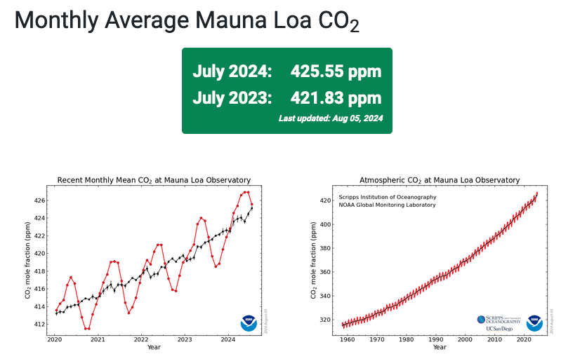
Diving into Earth.nullschool.net
CO₂ concentrations
A key number is 425 ppm, the current global average concentration

